Slide 1
GENERAL ASSEMBLY - Data Science DAT5 June 3, 2015 Alex Sherman
Notes:
Creating a health data ecosystem through SEMOSS

Slide 2
What factors correlate with a seller's listed price for online housing listings?
Problem Statement
The Washington D.C. tri-state area has myriad housing and apartment rental options. To aid my own apartment search – which lacked sufficient criteria to compare apartments - I conducted an analysis of the housing rental market for my final project in General Assembly’s Data Science course.

Slide 3
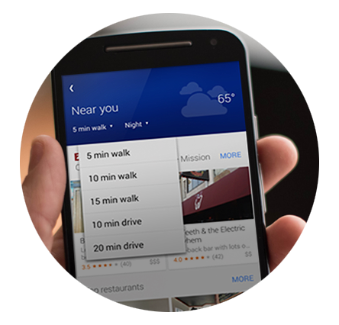
Collect data from Craigslist and Google Places API
Data Acquisition
To obtain my dataset, I took a two-step process: build a web scraper to acquire online housing listings; collect geographically relevant data from the Google Places API
Web Scraping
Google Places API
 | Category | Fields
1 | Housing Description | Price Listing text Listing title
2 | Housing Attributes | Date available Housing type If cats and dogs are allowed Laundry Parking # of bathrooms # of bedrooms Rental availability Smoking Square footage
3 | Location Data | City Country Data accuracy Latitude Location Longitude State
4 | Image Data | Average image dimensions # of images

Slide 4

Collect data from Craigslist and Google Places API
Data Acquisition
To obtain my dataset, I took a two-step process: build a web scraper to acquire online housing listings; collect geographically relevant data from the Google Places API
Web Scraping
Google Places API
<div class="mapAndAttrs">
<div class="mapbox">
<div id="map" class="viewposting"
data-latitude=“11.111111"
data-longitude="-22.22222"
data-accuracy=“3"></div>
#Create Google Places API URL
url=https://maps.googleapis.com/maps/api/place/
nearbysearch/json?
location= str(loc[0]) , str(loc[1])&
radius=1610&
rankby=prominence&
types&
keyword&
key=key
#add nearby grocery stores
types = 'types=grocery_or_supermarket&'
url = create_url(loc, types)
#add nearby Starbucks
keyword = 'keyword=Starbucks&'
url = create_url(loc, keyword)

Slide 5
Clean, Impute, Remove, Transform, Engineer, Repeat
 | Data Cleaning | Cities and States: Turn all instances to lower case to reduce differences in capitalization. 2. Replace all encodings with blank string 3. Correct misspellings 4. Group logical instances
 | Impute missing values | To fill in missing values, I calculated and imputed the mean value by each grouping of housing type (e.g. apartment) and number of bathrooms
 | Outlier Detection | Price: Remove duplicates and listings above $10,000 or below $100
 | Data Transformation | Convert text describing whether cats were allowed binary values (1) = yes, cat are allowed or (0) no, cats are not allowed
 | Feature Engineering | Determined weekday each listing was posted, by extraction information from posted data

Slide 6
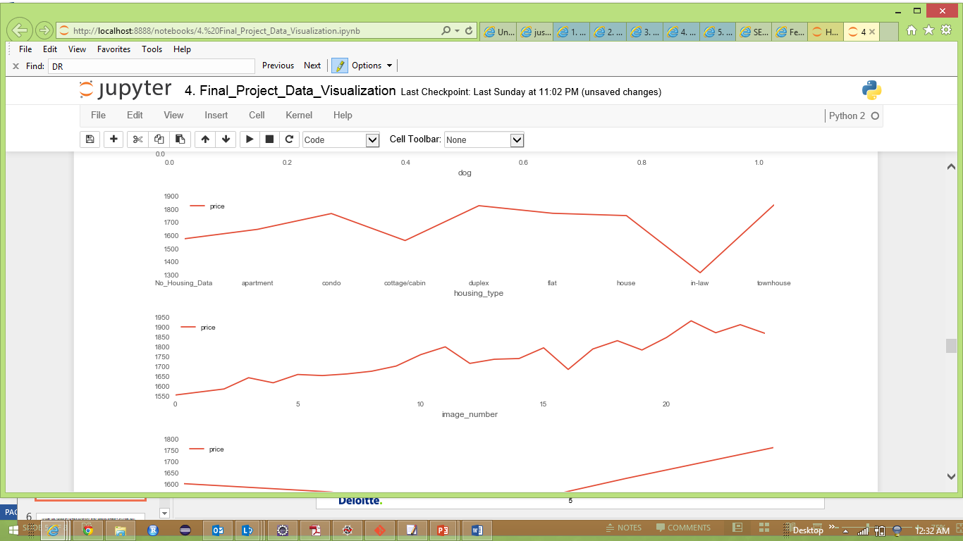
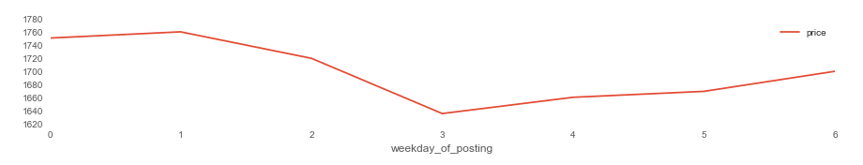
Data.groupby(field)['price'].mean().plot()
Problem Statement

Slide 7
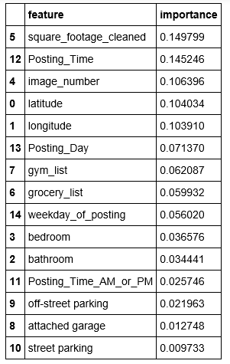

Random forest > Ridge > Lasso > Linear
Analysis Conclusions
My analysis concluded that there are significant location specific places of interest that influence the listing price, but are rarely mentioned in listings. In particular, information about nearby gyms and grocery stores both were in my top eight features throughout my analysis.
Selected Features
Final Model
Final model features:
attached garage
bathroom
bedroom
Grocery list
Gym list
Image number
latitude
longitude
off-street parking
Posting Day
Posting Time
Posting Time AM or PM
Square footage
Square footage cleaned
street parking
Weekday of posting

Slide 8
GENERAL ASSEMBLY - Data Science DAT5 June 3, 2015 Alex Sherman
Notes:
Creating a health data ecosystem through SEMOSS

